Slide 1
RePlAce (Task 9) Advancing Solution Quality and Routability Validation in Global Placement
C.-K. Cheng, A. B. Kahng, I. Kang and L. Wang
Code maintainer: Mingyu Woo

Slide 2
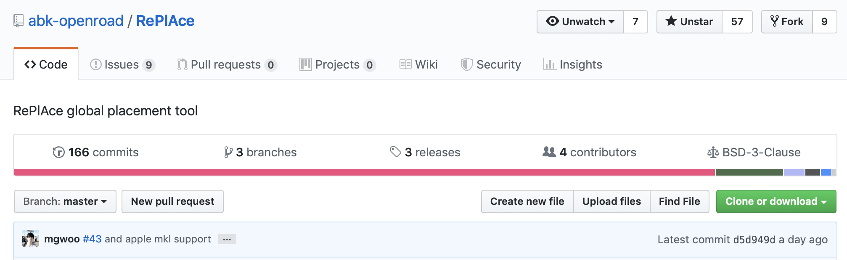
Open-sourced in GitHub
RePlAce has been public in 01/20/2019
Link: https://github.com/abk-openroad/RePlAce
License: BSD-3-clause license
166 commits.
Received 40 issues, 31 is solved.

Slide 3
Enhancement
Achieved below changes:
Faster Cimg visualizer has been ported.
RePlAce can understand LEF/DEF file. (Commercial format)
Timing-driven placement with OpenSTA has been enabled.
Routability-driven modes with commercial format is enabled.
Fragmented-ROW support in DEF.
Supported Technologies
TSMC 65
Fujitsu 55
FreePDK 45
ST FDSOI 28
TSMC 16 (7.5T/9T)
GF 14
ASAP 7

Slide 4
Real-world Example
Black-parrot TSMC-65LP with Density 80% (Timing-Driven)

Slide 5
Real-world Example
Coyote TSMC-16FFC with Density 80% (Timing-Driven)

Slide 6
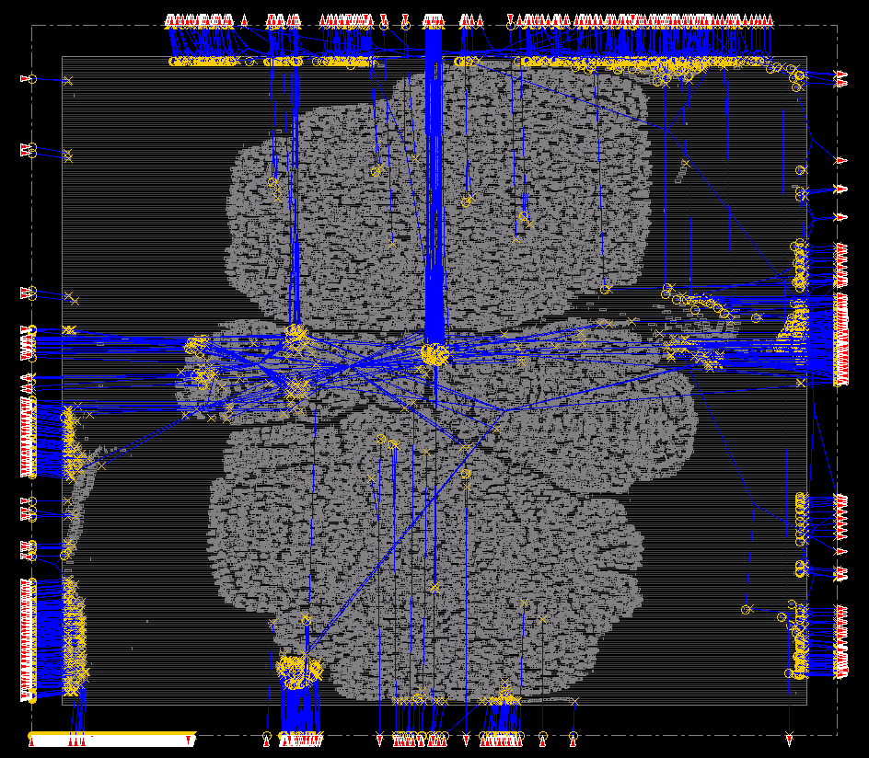
Future work
ioPlacer porting is still ongoing… [w/UFRGS]
Solve un-readability issues in the near future.
Bookshelf-oriented data structure is very brittle.
Rewrite the code based on well-formed global DB.

Slide 7


OpenDP (Task 9) Open Source Detailed Placement Engine
SangGi Do, Mingyu Woo, and Seokhyeong Kang

Slide 8
OpenDP: Open-source Legalizer (Task 9)
Multi-height and Fence-region aware legalizer.
Targeted for ICCAD 2017 Contest Problem C.
TETRIS-based Simulated Annealing has been used
Global Placer result in Fence-region
Legalized result in Fence-region
S. Do, M. Woo and S. Kang, "Fence-Region-Aware Mixed-Height Standard Cell Legalization", Proc. Great Lakes Symposium on VLSI, 2019, pp. 259-262.

Slide 9
OpenDP: Open-source Legalizer (Task 9)
Open-sourced as BSD-3-clause
Link: https://github.com/sanggido/OpenDP
Limitation
OpenDP uses custom parser for LEF/DEF → Brittle.
Porting the Si2 LEF/DEF parser is ongoing.
Human resource is limited;
Original code writer is working at Samsung…
S. Do, M. Woo and S. Kang, "Fence-Region-Aware Mixed-Height Standard Cell Legalization", Proc. Great Lakes Symposium on VLSI, 2019, pp. 259-262.

